Slide 1
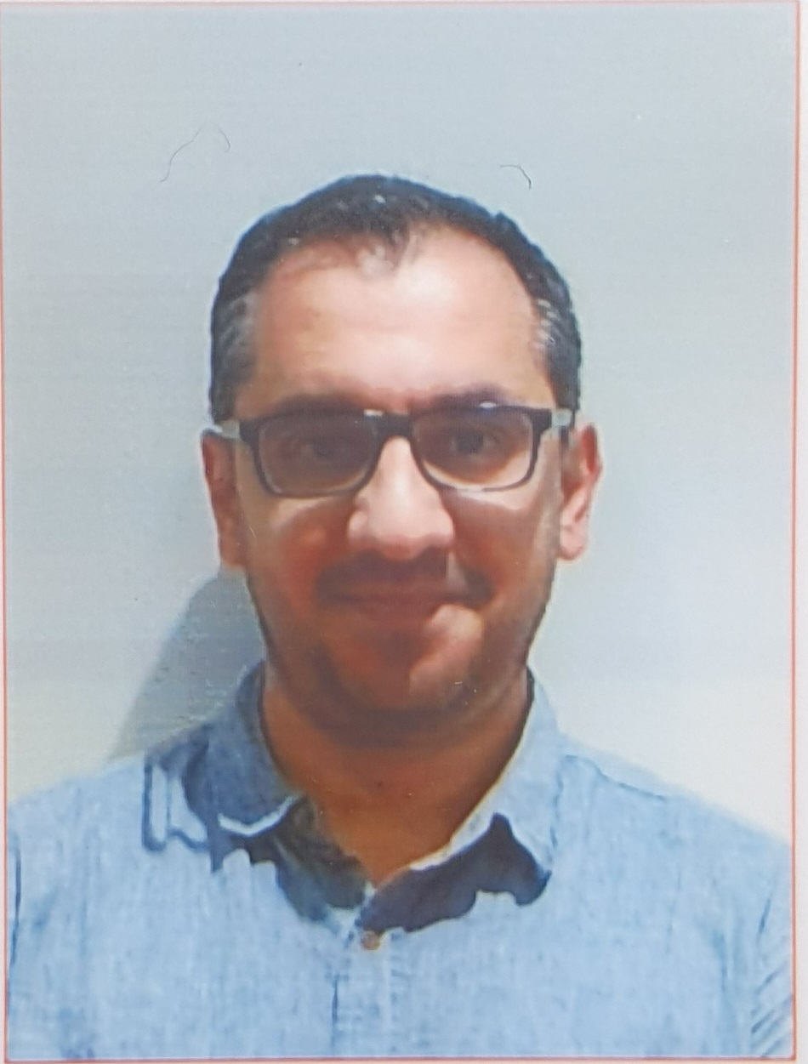
Introduction to Software Engineering (ISE102) Tutorial Week 10

Slide 2
Week 10 Outline
Preparation and Guideline for Assessment 1 – Part 2 and 3
Introduction to GUI Programming
Creating Your First Tkinter Window
Hands-On Activity 1 – Your First App Window
Hands-On Activity 2 – Experiment with Window Behavior
Widgets: The Building Blocks of GUI Apps
Example 2: Widgets in Action
Hands-On Activity 3: Add More Widgets
Geometry Managers (How Widgets Are Placed)
Event Handling

Slide 3
Week 10 Outline
Login Window Case Study
Popup Windows & Messages
Connecting GUI with Backend
Error Handling in GUI
Logging User Actions
Sample Java GUI Comparison
Testing Your GUI
Research & Discussion Questions
Problem-Solving with GUI (Python Version)
Problem-Solving with GUI (Java Version)
MQs designed in Week 10 (Python Tkinter)

Slide 4
Preparation and Guideline for Assessment 1 – Part 2 and 3
PART 2: SOFTWARE DEVELOPMENT (CLI + GUI)
Purpose
Build your working University Application system — a Command-Line App (CLIUniApp) and, if possible, a Graphical App (GUIUniApp) — based on your group’s design and analysis from Part 1.

Slide 5
Preparation and Guideline for Assessment 1 – Part 2 and 3
What to Do
1. Plan Early
Revisit your Part 1 diagrams, use-cases, and class design.
Make sure your code matches your UML and requirements.
Choose one programming language – either Java or Python.
Divide the work among group members (e.g. Model / Controller / View or Sections A–E).
Hint: Create a simple to-do list for each member before you start coding.

Slide 6
Preparation and Guideline for Assessment 1 – Part 2 and 3
2. Follow the Functional Requirements
Your program must have four main menus:
Menu | What it Does | Who Uses It
University System | Lets users switch between Student and Admin systems | Everyone
Student System | Register / Login (with Regex validation for email and password) | Students
Subject Enrolment System | Enrol, Remove, View Subjects, Change Password | Logged-in Students
Admin System | Show all students, Group or Sort them, Remove or Clear data | Admin Only

Slide 7
Preparation and Guideline for Assessment 1 – Part 2 and 3
Extra Tips
Always test each menu before moving to the next one.
Include a short README file explaining how to run the program.
Make sure your CLI and GUI versions work consistently.
Keep your code clean and commented.
Submit one .zip file per group (CLI + GUI + README).

Slide 8
3. Handle File Operations
Your program must save and load data from a file called students.data.
All CRUD operations (Create, Read, Update, Delete) must connect to this file.
You can store data using object serialization, or in JSON or CSV format — follow your design from Part 1.
Make sure these actions work correctly:
Read → Load existing students from the file
Write → Save new or updated student data
Clear → Remove all records safely
Hint: Always test reading and writing multiple times to ensure your file updates correctly.

Slide 9
4. Follow the Regex Rules: Use Regular Expressions (Regex) to validate inputs.
Field | Validation Rule | Example❌
Email | Must follow this pattern: firstname.lastname@university.com | john.smith@university.com X john123@gmail.com
Password | Must start with an uppercase letter, include at least 5 letters, and at least 3 digits | Helloworld123 X helloworld123
Hint: Regex helps prevent invalid registrations (e.g., wrong email or weak password).

Slide 10
5. Generate Random Values: Automatically generate IDs and marks when needed.
Item | Rule | Example
Student ID | 6-digit random number (000001 – 999999) | 003215
Subject ID | 3-digit random number (001 – 999) | 084
Marks | Random value between 25 and 100 | 76
Grade | Based on mark range → HD, D, C, P, F | e.g., HD for 85, P for 55
Hint: Use Python’s random or Java’s Random/Math.random() to generate these values.

Slide 11
6. Error & Exception Handling
Your app must handle errors smoothly — never crash!
What to Check | How to Handle It
Invalid input | Show a clear message instead of crashing (e.g., “Please enter a number between 1–4.”)
Too many subjects | Stop enrolment when a student reaches 4 subjects.
Duplicate registration | Check the file before adding a new student to prevent duplicates.
Hint: Use try-except in Python or try-catch in Java to manage user input safely.

Slide 12
7. GUIUniApp (Optional but Rewarding)
If your group completes the Graphical User Interface (GUI) version, you can earn the full 7 marks.
GUI Window | What It Should Do
Login Window | Allow only registered students to log in. Show an error message for invalid users.
Enrolment Window | Let logged-in students add up to 4 subjects.
Subject Window | Display subjects, marks, and grades clearly.
Error/Alert Windows | Pop-up windows to handle login or enrolment errors gracefully.

Slide 13
7. GUIUniApp (Optional but Rewarding)
Hint:
In Python, use Tkinter or PyQt.
In Java, use JavaFX or Swing.
Keep GUI simple but functional — matching your CLI features.

Slide 14
Preparation and Guideline for Assessment 1 – Part 2 and 3
WHAT TO SUBMIT
File Name Format
Name your submission like this: group<group-number>-Cmp1<lab-number>.zip Example: group3-Cmp1L05.zip

Slide 15
Preparation and Guideline for Assessment 1 – Part 2 and 3
Dear Farshid,
Good evening, thanks for your time for listening to our presentation. I just want to ask is there a report we need to submit or our Zip File will be all the things we need to submit? Thanks again for this semester, we really appreciate it!
Kind regards,

Slide 16
Preparation and Guideline for Assessment 1 – Part 2 and 3
Dear Student,
Thank you for your presentation and kind message.
For submission, please refer to Week 10 – Preparation for Part 2 and 3 on Canvas.
What to Submit
Your submission should be a .zip file named as follows: group<group-number>-Cmp1<lab-number>.zip Example: group3-Cmp1L05.zip
Only one submission per group is required — please upload it to Canvas before the deadline.

Slide 17
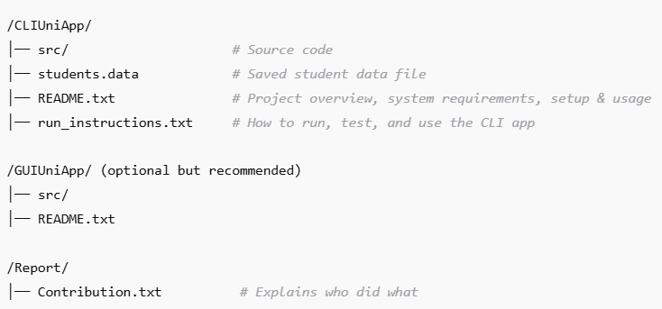
Preparation and Guideline for Assessment 1 – Part 2 and 3
.zip File Contents
Make sure your .zip file includes:

Slide 18
Preparation and Guideline for Assessment 1 – Part 2 and 3
Also include:
Project overview
System requirements
Installation and setup instructions
Configuration details
How to run, test, and use the software

Slide 19
Preparation and Guideline for Assessment 1 – Part 2 and 3
Do not include:
Automatically generated build, cache, or log files
Local environment or IDE-specific settings
Large dependency folders (e.g., node_modules/)

Slide 20
Preparation and Guideline for Assessment 1 – Part 2 and 3
Part 2 Deadline: Sunday, Week 13 (9 Nov) – 11:59 PM Only one submission per group (upload to Canvas)
Please double-check your .zip file before uploading to ensure it opens and runs correctly.
Kind regards, Dr. Farshid Keivanian

Slide 21
WHAT TO AVOID
X | Common Mistake
X AI-generated code | Risk of 0 marks — detected by similarity tools and AI-pattern checks.
X Non-functional code | Incomplete or broken features earn only minimal marks.
X Unclear contribution | Missing Contribution.txt can lead to mark deductions.

Slide 22
WHAT TO AVOID
X | Common Mistake
X Late submission (without approval) | Must follow the UTS late policy.
X Inconsistent input/output formatting | Your program’s output must exactly match the sample I/O — spacing, capitalization, indentation all matter.

Slide 23
HINTS & BEST PRACTICES
Test each menu separately before combining them.
Use controllers (e.g., StudentController, AdminController) for clean architecture and separation of logic.
Write helper methods for repeated actions like validation, file reading, or ID generation.
Keep the sample I/O open while testing — your output should look identical.
For GUI:
Python: use tkinter
Java: use JavaFX
Final check: run your project on another computer before submitting — to ensure it works everywhere.

Slide 24
Preparation and Guideline for Assessment 1 – Part 2 and 3
PART 3: SHOWCASE PRESENTATION
When & Format
Held in Week 12 or Week 13 during your lab session
Each group: 15 minutes presentation + 3 minutes Q&A
In-person attendance is mandatory
Absence = 0 marks (no exceptions unless approved with evidence)

Slide 25
Preparation and Guideline for Assessment 1 – Part 2 and 3
What to DO in Your Showcase
Each group member must:
Run the working application (CLI or GUI) live.
Show your contribution – walk through the part of code you wrote.
Speak clearly – explain what your part does and how it connects to the rest of the system.
Answer tutor questions confidently (about design, logic, or testing).
Hint: Practise as a group once or twice before the showcase — time your parts!

Slide 26
Preparation and Guideline for Assessment 1 – Part 2 and 3
Marking (Total: 5 marks)
Criteria | Marks | Description
Working software demo | 2 | The program runs correctly and performs all core functions.
Clear and engaging speech | 1 | Presentation is clear, confident, and easy to follow.
Code walkthrough (own part) | 1 | Each member explains their code contribution accurately.
Answers to questions | 1 | Responds confidently and shows understanding of the project.

Slide 27
Preparation and Guideline for Assessment 1 – Part 2 and 3
PRESENTATION TIPS
Rehearse your screen flow and main talking points before the presentation.
Keep your speech within 2–3 minutes per member to stay on time.
Prepare for live questions — be ready to explain:
What classes or methods you implemented
How file operations work (read/write/clear)
How regex validation was applied
What challenges you faced and how you solved them

Slide 28
Preparation and Guideline for Assessment 1 – Part 2 and 3
Show live results such as enrolment, grouping, or partitioning in action.
Have a backup plan — record a short demo video or take screenshots in case of technical issues.
Tip: Practise switching between group members smoothly — each should introduce their part confidently.

Slide 29
Preparation and Guideline for Assessment 1 – Part 2 and 3
COMMON QUESTIONS & MODEL ANSWERS
Question | Suggested Answer
What is the difference between the CLI and GUI app? | The CLIUniApp uses text-based menus, while the GUIUniApp has graphical windows for login and enrolment. Both use the same students.data file.

Slide 30
Preparation and Guideline for Assessment 1 – Part 2 and 3
COMMON QUESTIONS & MODEL ANSWERS
Question | Suggested Answer
How does your system store data? | It serializes Student objects into students.data, so all data is saved and reloaded across sessions.

Slide 31
Preparation and Guideline for Assessment 1 – Part 2 and 3
COMMON QUESTIONS & MODEL ANSWERS
Question | Suggested Answer
How did you validate emails and passwords? | Using Regex: the email must end with @university.com, and the password must start with an uppercase letter, have ≥5 letters and ≥3 digits.

Slide 32
Preparation and Guideline for Assessment 1 – Part 2 and 3
COMMON QUESTIONS & MODEL ANSWERS
Question | Suggested Answer
How do you prevent duplicate registrations? | Before saving to the file, the system checks if the email already exists. If it does, it blocks registration.

Slide 33
Preparation and Guideline for Assessment 1 – Part 2 and 3
COMMON QUESTIONS & MODEL ANSWERS
Question | Suggested Answer
How does the admin partition or group students? | It loops through all students, then categorizes them based on marks (e.g., ≥50 = Pass) and groups by grade (HD, D, C, P, F).

Slide 34
Preparation and Guideline for Assessment 1 – Part 2 and 3
COMMON QUESTIONS & MODEL ANSWERS
Question | Suggested Answer
What happens if a student enrols in more than 4 subjects? | The program prevents it and shows: “Students are allowed to enrol in 4 subjects only.”

Slide 35
Preparation and Guideline for Assessment 1 – Part 2 and 3
COMMON QUESTIONS & MODEL ANSWERS
Question | Suggested Answer
What did you personally contribute? | (Example) I implemented the StudentController and Subject class, including enrolment logic and file handling.

Slide 36
Preparation and Guideline for Assessment 1 – Part 2 and 3
COMMON QUESTIONS & MODEL ANSWERS
Question | Suggested Answer
What improvements could be added later? | Expanding GUI for admin functions, integrating a database (e.g., SQLite), or adding cloud-based data storage.

Slide 37
Preparation and Guideline for Assessment 1 – Part 2 and 3
Hi Professor, I hope you're doing well. We’ve reviewed the Part 1 requirements and understand that Part 2 involves implementing a student enrolment system, including both CLI and GUI components. Our group would like to start planning for Part 2 of Assessment 1, and we were wondering if you could please let us know the specific requirements for Part 2? Ｗe’d like to clarify the tasks early so we can arrange our meeting and start preparing. Thank you very much for your time and support! Best regards,

Slide 38
Preparation and Guideline for Assessment 1 – Part 2 and 3
Dear Student,
Thank you for your message. Yes — Part 2 focuses on implementing the software system based on your Part 1 analysis. It includes both the CLI (CLIUniApp) and an optional GUI challenge (GUIUniApp).
You’ll implement all the system menus (University, Student, Admin, and Enrolment) exactly as described in the provided specification and sample I/O.
I recommend your group review the marking scheme early and assign each section (A–E) among members for balanced contribution.
Best regards, Farshid

Slide 39
Preparation and Guideline for Assessment 1 – Part 2 and 3
Dear Professor Farshid Keivanian, I hope you're doing well! I’m currently reviewing the tasks for your course and planning my schedule. I just wanted to confirm whether all the required tasks and assessments — such as presentations, reports, or final submissions — will be completed before the official course deadline. If there are any updates, extensions, or additional requirements I should be aware of, I’d really appreciate it if you could let me know. Thank you very much for your time and support! Best regards,

Slide 40
Preparation and Guideline for Assessment 1 – Part 2 and 3
Dear Ziyang,
All required tasks and assessments — including the report, code submission (Part 2), and Showcase (Part 3) — will be completed before the official end of the semester.
Part 2 is due Sunday, Week 13 (9 Nov), and the Showcase (Part 3) occurs in Week 12–13 during your usual class time. There are no additional submissions beyond these.
Best regards,
Farshid

Slide 41
Preparation and Guideline for Assessment 1 – Part 2 and 3
Dear Farshid,
I hope you are doing well.
I am writing regarding the Project Showcase for 32555 Fundamentals of Software Development. Our group is Group #9 – Friday 12:00 PM, CMP1 06. I have two questions that I would like to clarify:
Could you please confirm whether our group’s showcase will be scheduled in Week 12 or Week 13, and whether it will be conducted online or in person?
If the showcase is in person, would it be possible to arrange for our group to present in Week 12? I have an international flight booked on 26 October, which may overlap with the Week 13 schedule.
Thank you very much for your time and understanding. Please let me know if you need any additional details from me.
Kind regards,

Slide 42
Preparation and Guideline for Assessment 1 – Part 2 and 3
Dear Ziyang,
Thank you for informing me. The Showcase will be conducted during Week 12 and Week 13 in your usual lab time.
Since you have an international flight, I’ll schedule your group’s presentation in Week 12. Please ensure your group is ready to present the full working project and your individual parts.
Best regards,
Farshid

Slide 43
Preparation and Guideline for Assessment 1 – Part 2 and 3
Hi Sir Farshid Keivanian,
When our group was reading the specifications for Assessment Part 2 and 3, we noticed that the GUI task is counted in the marking scheme to complete 50 points even though it’s stated as a challenge task and not mandatory.
To get full marks for the project, do we:
Deliver parts A through D of the marking scheme OR
Deliver parts A through D, while also including E
Your advice is greatly appreciated!
Best

Slide 44
Preparation and Guideline for Assessment 1 – Part 2 and 3
Dear Leiko,
Great question. The GUI component is a challenge task — not mandatory but required if your group aims for full marks (50/50) in Part 2.
Delivering parts A–D (CLI only) can still earn strong marks, but the GUI (part E) provides the final 7 marks and demonstrates advanced skills.
I recommend attempting it if your group has time to integrate it smoothly.
Best regards, Farshid

Slide 45
Introduction to GUI Programming
GUI (Graphical User Interface) means using buttons, windows, and menus instead of typing commands.
Example: It’s like using the ANZ Bank app instead of writing commands in a black console window.
Tkinter is Python’s built-in tool for making GUIs.
You don’t need to install it — it comes with Python.
Works smoothly on VS Code, both Windows and macOS.

Slide 46
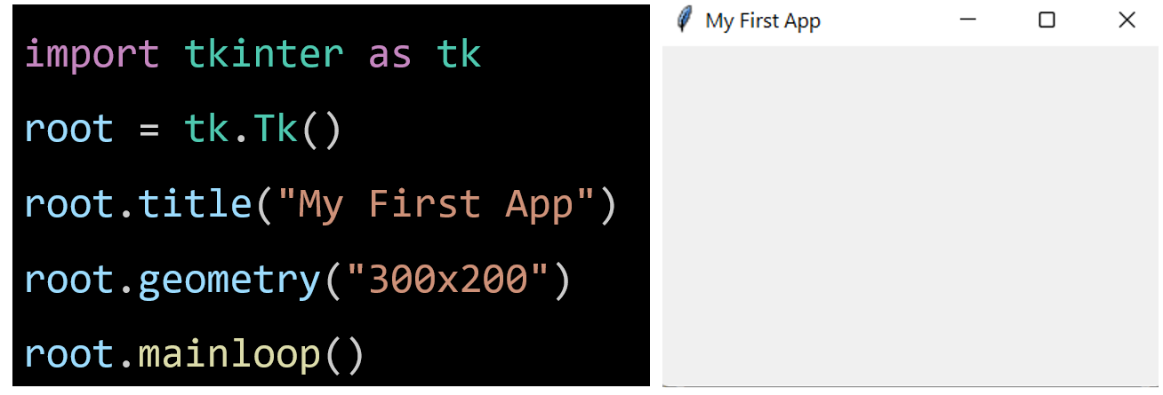
Creating Your First Tkinter Window
Tk() → Opens your app’s workspace, like clearing a desk before you start working.
title() → Gives your window a name (appears at the top).
geometry() → Sets the window size (width × height).
mainloop() → Keeps the window open and running until you click the button.

Slide 47
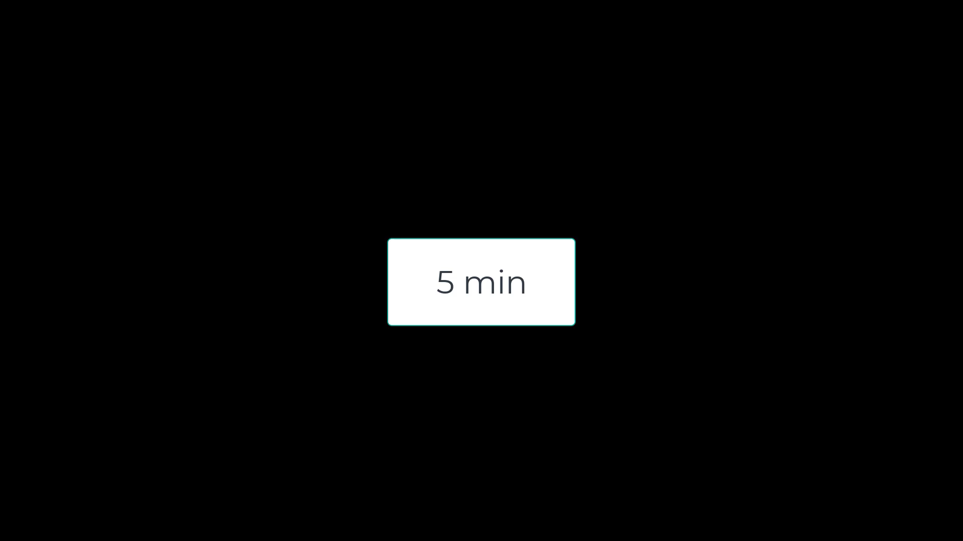
Hands-On Activity 1 – Your First App Window
Goal: Get comfortable running the Tkinter window. Steps:
Use the example 1 (sample code).
Change the window title to your name (e.g., "Farshid’s App").
Change the size from "300x200" to something else, like "400x300".
Run the code and watch your own custom window appear!
Challenge: Can you make it a square window (same width and height)?

Slide 48
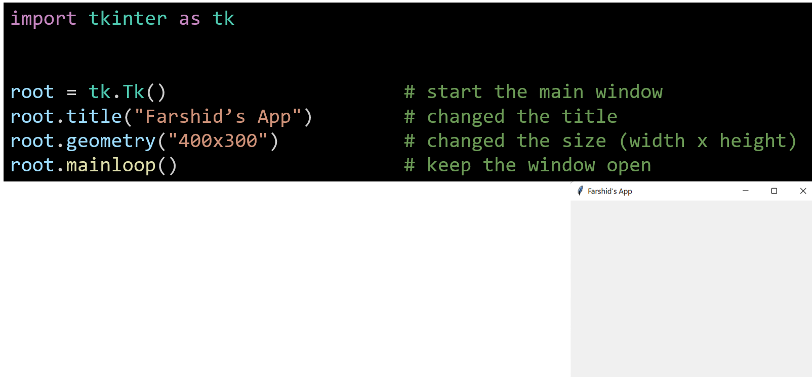
Hands-On Activity 1 – Your First App Window
tk.Tk() → opens a new blank window.
title("Farshid’s App") → sets your window name at the top.
geometry("400x300") → makes the window 400 pixels wide and 300 pixels tall.
mainloop() → tells Python to keep it running until you close it manually.

Slide 49
Hands-On Activity 1 – Your First App Window
root.geometry("300x300") # same width and height
This creates a square window — try resizing and notice the shape!

Slide 50
Hands-On Activity 2 – Experiment with Window Behavior
Goal: Understand what each line really does. Steps:
See what changes — for example:
What happens if you remove geometry()?
What if you remove mainloop()?
Write one sentence: “I learned that …” after each test.
Hint: You’ll discover which parts are essential for the window to appear and stay open!

Slide 51
Hands-On Activity 2 – Experiment with Window Behavior
If we remove geometry(), the window still opens — but the size changes automatically (it shrinks). If we remove mainloop(), the window opens and disappears instantly — our app closes right away!
Lesson Learned:
geometry() controls how big it looks.
mainloop() keeps it alive and visible.

Slide 52
Widgets: The Building Blocks of GUI Apps
Widget | What it Does | Example
Label | Shows text on screen | “Email:”
Entry | Lets user type input | user types email
Button | Performs an action | “Login” click
Frame / LabelFrame | Groups items together | Login box area
Toplevel | Opens a new window | Success popup

Slide 53
Widgets: The Building Blocks of GUI Apps
Real-World Analogy: Think of your app window as a desk.
Widgets are the furniture you place on it:
Label = name tag
Entry = notepad for typing
Button = doorbell that triggers something
Frame = a tray keeping things organized
Toplevel = a new mini-desk popping up for extra work!

Slide 54
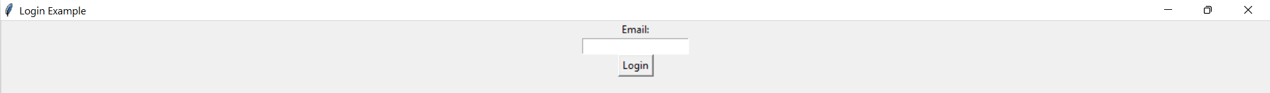
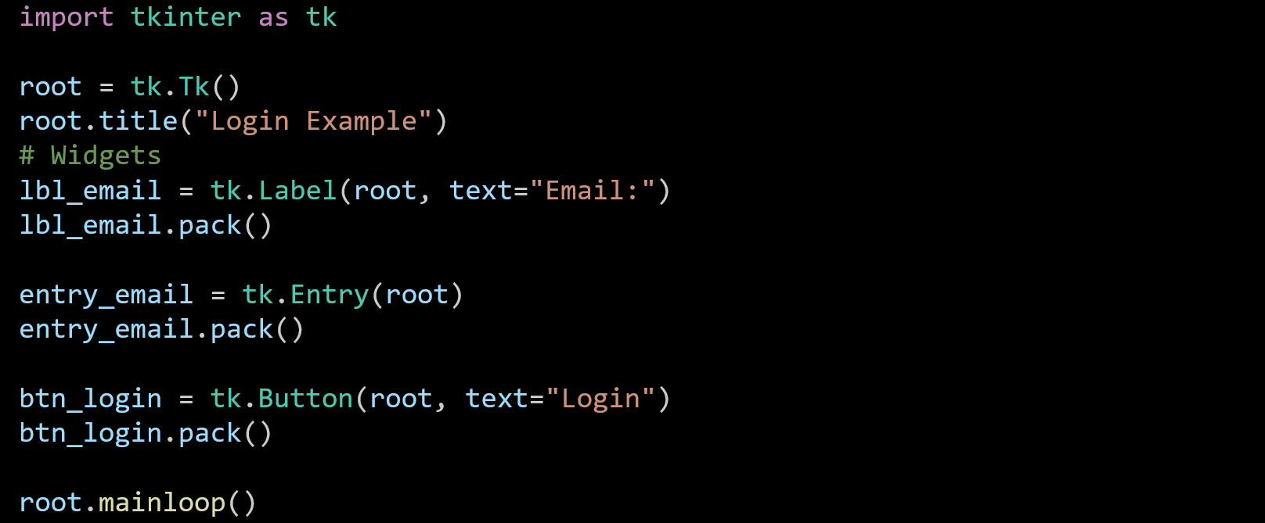
Example 2: Widgets in Action
This imports Tkinter, Python’s built-in tool for making windows, buttons, and text boxes. We use the short name tk so we can write less later (e.g., tk.Label instead of tkinter.Label).

Slide 55
Example 2: Widgets in Action
This creates the main window — like opening your app’s workspace or desktop. Everything you make (labels, buttons, boxes) will sit inside this window.

Slide 56
Example 2: Widgets in Action
Sets the window name that appears at the top (the title bar). You can write anything you like, e.g., "My First GUI".

Slide 57
Example 2: Widgets in Action
Makes a label (a piece of text) inside the main window (root). It will display the text “Email:” on the screen.

Slide 58
Example 2: Widgets in Action
Displays the label in the window. Without pack(), the label exists but doesn’t show up yet. Think of pack() as “place it nicely” on the window.

Slide 59
Example 2: Widgets in Action
Creates an input box where the user can type something (like an email). Entry means a single-line text box.

Slide 60
Example 2: Widgets in Action
Shows the input box under the label.

Slide 61
Example 2: Widgets in Action
Creates a button with the word “Login” on it. (You can later make it do something when clicked.)

Slide 62
Example 2: Widgets in Action
Places the button under the input box.

Slide 63
Example 2: Widgets in Action
Starts the main event loop — it keeps your window open and active until you close it. Without this line, your app would open and close instantly.

Slide 64
Example 2: Widgets in Action
In short:
Tk() → makes the window
Label, Entry, Button → add things to it
pack() → show them
mainloop() → keep it open

Slide 65
Hands-On Activity 3: Add More Widgets
Goal: Build a small login screen using Tkinter widgets.
Steps:
Copy the code above.
Add another label and entry for Password.
Change the button text to “Submit”.
Run your program and test typing in both boxes.
Challenge: Can you add a LabelFrame called “Login Panel” to group both labels and entries inside?

Slide 66
Hands-On Activity 3: Add More Widgets
import tkinter as tk
root = tk.Tk() # create main window
root.title("Login Example") # window title
# Create a LabelFrame to group login items
login_frame = tk.LabelFrame(root, text="Login Panel", padx=10, pady=10)
login_frame.pack(padx=20, pady=20)
# Email label and entry
lbl_email = tk.Label(login_frame, text="Email:")
lbl_email.pack()
entry_email = tk.Entry(login_frame)
entry_email.pack()
# Password label and entry
lbl_password = tk.Label(login_frame, text="Password:")
lbl_password.pack()
entry_password = tk.Entry(login_frame, show="*") # hides text with '*'
entry_password.pack()
# Submit button
btn_submit = tk.Button(login_frame, text="Submit")
btn_submit.pack()
root.mainloop() # keep the window open
Brings in Tkinter, the library for creating GUI (Graphical User Interface) apps.

Slide 67
Hands-On Activity 3: Add More Widgets
import tkinter as tk
root = tk.Tk() # create main window
root.title("Login Example") # window title
# Create a LabelFrame to group login items
login_frame = tk.LabelFrame(root, text="Login Panel", padx=10, pady=10)
login_frame.pack(padx=20, pady=20)
# Email label and entry
lbl_email = tk.Label(login_frame, text="Email:")
lbl_email.pack()
entry_email = tk.Entry(login_frame)
entry_email.pack()
# Password label and entry
lbl_password = tk.Label(login_frame, text="Password:")
lbl_password.pack()
entry_password = tk.Entry(login_frame, show="*") # hides text with '*'
entry_password.pack()
# Submit button
btn_submit = tk.Button(login_frame, text="Submit")
btn_submit.pack()
root.mainloop() # keep the window open
Creates the main window for your app and gives it a title that appears at the top bar.

Slide 68
Hands-On Activity 3: Add More Widgets
A LabelFrame is like a box that groups related items together (here, all login items).
text="Login Panel" → the name of the frame shown on top.
padx and pady → add space inside and around the frame (so things don’t look squished).
import tkinter as tk
root = tk.Tk() # create main window
root.title("Login Example") # window title
# Create a LabelFrame to group login items
login_frame = tk.LabelFrame(root, text="Login Panel", padx=10, pady=10)
login_frame.pack(padx=20, pady=20)
# Email label and entry
lbl_email = tk.Label(login_frame, text="Email:")
lbl_email.pack()
entry_email = tk.Entry(login_frame)
entry_email.pack()
# Password label and entry
lbl_password = tk.Label(login_frame, text="Password:")
lbl_password.pack()
entry_password = tk.Entry(login_frame, show="*") # hides text with '*'
entry_password.pack()
# Submit button
btn_submit = tk.Button(login_frame, text="Submit")
btn_submit.pack()
root.mainloop() # keep the window open

Slide 69
Hands-On Activity 3: Add More Widgets
Adds a Label inside the frame to show the word “Email:”.
import tkinter as tk
root = tk.Tk() # create main window
root.title("Login Example") # window title
# Create a LabelFrame to group login items
login_frame = tk.LabelFrame(root, text="Login Panel", padx=10, pady=10)
login_frame.pack(padx=20, pady=20)
# Email label and entry
lbl_email = tk.Label(login_frame, text="Email:")
lbl_email.pack()
entry_email = tk.Entry(login_frame)
entry_email.pack()
# Password label and entry
lbl_password = tk.Label(login_frame, text="Password:")
lbl_password.pack()
entry_password = tk.Entry(login_frame, show="*") # hides text with '*'
entry_password.pack()
# Submit button
btn_submit = tk.Button(login_frame, text="Submit")
btn_submit.pack()
root.mainloop() # keep the window open

Slide 70
Hands-On Activity 3: Add More Widgets
Adds a text box where users can type their email.
import tkinter as tk
root = tk.Tk() # create main window
root.title("Login Example") # window title
# Create a LabelFrame to group login items
login_frame = tk.LabelFrame(root, text="Login Panel", padx=10, pady=10)
login_frame.pack(padx=20, pady=20)
# Email label and entry
lbl_email = tk.Label(login_frame, text="Email:")
lbl_email.pack()
entry_email = tk.Entry(login_frame)
entry_email.pack()
# Password label and entry
lbl_password = tk.Label(login_frame, text="Password:")
lbl_password.pack()
entry_password = tk.Entry(login_frame, show="*") # hides text with '*'
entry_password.pack()
# Submit button
btn_submit = tk.Button(login_frame, text="Submit")
btn_submit.pack()
root.mainloop() # keep the window open

Slide 71
Hands-On Activity 3: Add More Widgets
Another Label, this time for “Password:”.
import tkinter as tk
root = tk.Tk() # create main window
root.title("Login Example") # window title
# Create a LabelFrame to group login items
login_frame = tk.LabelFrame(root, text="Login Panel", padx=10, pady=10)
login_frame.pack(padx=20, pady=20)
# Email label and entry
lbl_email = tk.Label(login_frame, text="Email:")
lbl_email.pack()
entry_email = tk.Entry(login_frame)
entry_email.pack()
# Password label and entry
lbl_password = tk.Label(login_frame, text="Password:")
lbl_password.pack()
entry_password = tk.Entry(login_frame, show="*") # hides text with '*'
entry_password.pack()
# Submit button
btn_submit = tk.Button(login_frame, text="Submit")
btn_submit.pack()
root.mainloop() # keep the window open

Slide 72
Hands-On Activity 3: Add More Widgets
Adds a password box where what you type is hidden (shown as *).
import tkinter as tk
root = tk.Tk() # create main window
root.title("Login Example") # window title
# Create a LabelFrame to group login items
login_frame = tk.LabelFrame(root, text="Login Panel", padx=10, pady=10)
login_frame.pack(padx=20, pady=20)
# Email label and entry
lbl_email = tk.Label(login_frame, text="Email:")
lbl_email.pack()
entry_email = tk.Entry(login_frame)
entry_email.pack()
# Password label and entry
lbl_password = tk.Label(login_frame, text="Password:")
lbl_password.pack()
entry_password = tk.Entry(login_frame, show="*") # hides text with '*'
entry_password.pack()
# Submit button
btn_submit = tk.Button(login_frame, text="Submit")
btn_submit.pack()
root.mainloop() # keep the window open

Slide 73
Hands-On Activity 3: Add More Widgets
Creates a button with the label “Submit”. (We can later make it show a message or check the login when clicked.)
import tkinter as tk
root = tk.Tk() # create main window
root.title("Login Example") # window title
# Create a LabelFrame to group login items
login_frame = tk.LabelFrame(root, text="Login Panel", padx=10, pady=10)
login_frame.pack(padx=20, pady=20)
# Email label and entry
lbl_email = tk.Label(login_frame, text="Email:")
lbl_email.pack()
entry_email = tk.Entry(login_frame)
entry_email.pack()
# Password label and entry
lbl_password = tk.Label(login_frame, text="Password:")
lbl_password.pack()
entry_password = tk.Entry(login_frame, show="*") # hides text with '*'
entry_password.pack()
# Submit button
btn_submit = tk.Button(login_frame, text="Submit")
btn_submit.pack()
root.mainloop() # keep the window open

Slide 74
Hands-On Activity 3: Add More Widgets
import tkinter as tk
root = tk.Tk() # create main window
root.title("Login Example") # window title
# Create a LabelFrame to group login items
login_frame = tk.LabelFrame(root, text="Login Panel", padx=10, pady=10)
login_frame.pack(padx=20, pady=20)
# Email label and entry
lbl_email = tk.Label(login_frame, text="Email:")
lbl_email.pack()
entry_email = tk.Entry(login_frame)
entry_email.pack()
# Password label and entry
lbl_password = tk.Label(login_frame, text="Password:")
lbl_password.pack()
entry_password = tk.Entry(login_frame, show="*") # hides text with '*'
entry_password.pack()
# Submit button
btn_submit = tk.Button(login_frame, text="Submit")
btn_submit.pack()
root.mainloop() # keep the window open
Starts the main loop, keeping the app open until you close it manually.

Slide 75
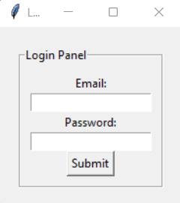
Hands-On Activity 3: Add More Widgets
In Short:
LabelFrame → a box to group widgets
Label → shows text
Entry → input field
Button → clickable action
mainloop() → keeps app running
import tkinter as tk
root = tk.Tk() # create main window
root.title("Login Example") # window title
# Create a LabelFrame to group login items
login_frame = tk.LabelFrame(root, text="Login Panel", padx=10, pady=10)
login_frame.pack(padx=20, pady=20)
# Email label and entry
lbl_email = tk.Label(login_frame, text="Email:")
lbl_email.pack()
entry_email = tk.Entry(login_frame)
entry_email.pack()
# Password label and entry
lbl_password = tk.Label(login_frame, text="Password:")
lbl_password.pack()
entry_password = tk.Entry(login_frame, show="*") # hides text with '*'
entry_password.pack()
# Submit button
btn_submit = tk.Button(login_frame, text="Submit")
btn_submit.pack()
root.mainloop() # keep the window open

Slide 76
Geometry Managers (How Widgets Are Placed)
There are 3 main ways to position things in your Tkinter window:
pack() → stacks widgets vertically or horizontally (like blocks on top of each other)
grid() → arranges widgets in a table with rows and columns
place() → puts widgets at an exact spot using x/y coordinates
Tip: Use grid() when making forms — like a Login page with “Email” and “Password” side by side in neat rows.

Slide 77
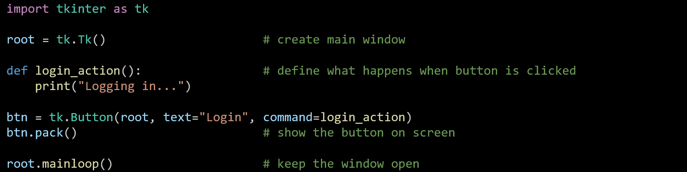
Event Handling
Tkinter apps react when something happens — this is called an event (like clicking a button). We can make our own function that runs when an event happens — and connect it to a widget.
Brings in Tkinter — Python’s tool for making GUI apps (windows, buttons, text boxes).

Slide 78
Event Handling
Tkinter apps react when something happens — this is called an event (like clicking a button). We can make our own function that runs when an event happens — and connect it to a widget.
Creates the main app window — like opening your workspace where everything will appear.

Slide 79
Event Handling
Tkinter apps react when something happens — this is called an event (like clicking a button). We can make our own function that runs when an event happens — and connect it to a widget.
Makes a function that runs when the user clicks the button. Here, it just prints a message on the console — later, we can make it show a popup.

Slide 80
Event Handling
Creates a button inside the window (root).
text="Login" → label on the button
command=login_action → tells Tkinter to run the function when the button is clicked.

Slide 81
Event Handling
Displays the button on the screen (places it neatly in the window).

Slide 82
Event Handling
Keeps the window open and running until you close it — this is the app’s heartbeat.

Slide 83
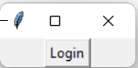
Event Handling
In Short
Event: something that happens (like a button click).
Function: tells the program what to do when that event happens.
command=... → connects the event to the function.

Slide 84
Login Window Case Study
GUIBankApp (Login Module)
Title: “Sign In”
Labels: Email, Password
Buttons: Login, Cancel
Password field: use show='*' to hide what’s typed
If correct: show a “Welcome!” popup
If wrong: show an error popup
Analogy: Just like logging into UTS Canvas — you type your email and password, and the system checks them in a database before letting you in.

Slide 85
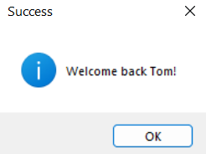
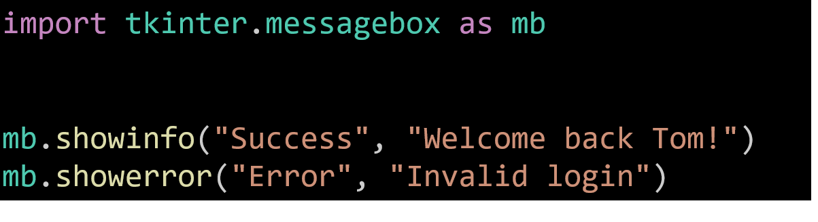
Popup Windows & Messages
Tkinter can show pop-up messages using messagebox.
showinfo() → shows a friendly message
showerror() → shows a red error message
Analogy: Pop-ups are like notifications on your phone — they appear, tell you something, then disappear.

Slide 86
Connecting GUI with Backend
In our Bank App, different files have different jobs:
File | Purpose
model.py | Stores user data and passwords
controller.py | Records user activity in log.txt
frame_view.py | Builds the login screen (GUI frame)
main_view.py | Loads and runs the app window
Analogy: Think of your app like a bank:
Frontend (GUI) = the teller desk you interact with
Backend (Code & Database) = the server room that checks and stores your info

Slide 87
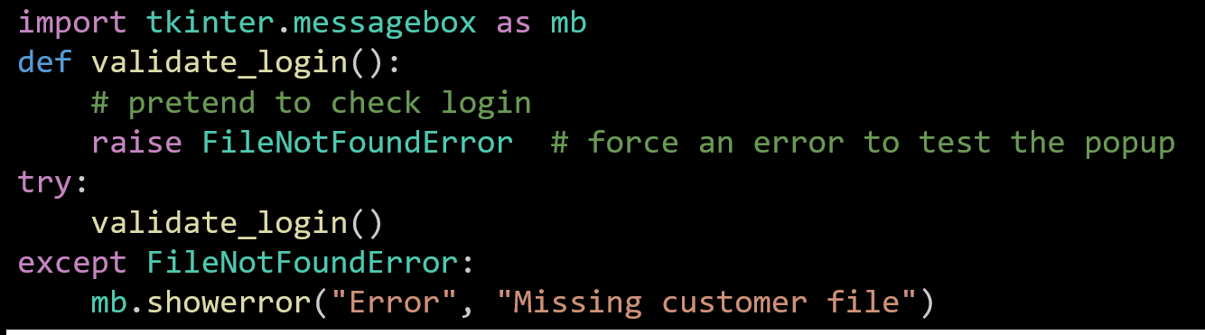
Error Handling in GUI
Use try–except to stop your program from crashing if something goes wrong.
def validate_login(): → creates a fake login function.
raise FileNotFoundError → tells Python to pretend an error happened (for testing).

Slide 88
Error Handling in GUI
try: → “Try to do this.”
except FileNotFoundError: → “If that kind of error happens, show a red error box.”

Slide 89
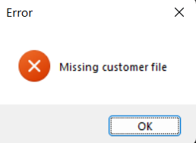
Error Handling in GUI
Now it will open a pop-up that says:
“Missing customer file”

Slide 90
Error Handling in GUI
In Simple Terms: “Try to do this. If it fails, show an error instead of crashing.”
Analogy: Like an ATM that says
“Card not recognized” instead of freezing or turning off.

Slide 91
Logging User Actions
After each successful login, the app saves it to a file:
controller.save("log.txt")
Why: To keep a record of who logged in and when — for security and tracking.
Analogy: Just like an ATM machine log, it records each transaction for safety.

Slide 92
Sample Java GUI Comparison
Aspect | Python (Tkinter) | Java (Swing)
Create window | Tk() | JFrame()
Button event | command= | addActionListener()
Popup | messagebox | JOptionPane
Layout | grid() | BorderLayout
Note: Different languages, same logic — just different words!

Slide 93
Testing Your GUI
Before submission, test your app carefully:
Try typing in the email and password boxes
Test both correct and wrong logins
Check if the log file is created correctly
Run it on different computers (Windows, macOS, etc.)
Analogy: Just like testing a MyGov online form — make sure every input works, errors show properly, and nothing breaks!

Slide 94
Research & Discussion Questions
Why is GUI important in modern apps?
➡ Because users prefer visual interaction over command lines.
Should login data be stored in plain text files?
➡ No, use encryption or databases for security (Australian Privacy Act).

Slide 95
Problem-Solving with GUI (Python Version)
Task: Build a Simple Login System (Python Tkinter)
Goal: Make a mini login window that checks if the user enters the correct email and password.
Steps:
Create two input boxes — one for email and one for password.
Add a Login button.
When the button is clicked:
If the email = tom.s@test.com and password = tom222, show a Welcome message.
Otherwise, show an Error message.
Hint: Use messagebox.showinfo() and messagebox.showerror() for pop-ups.

Slide 96
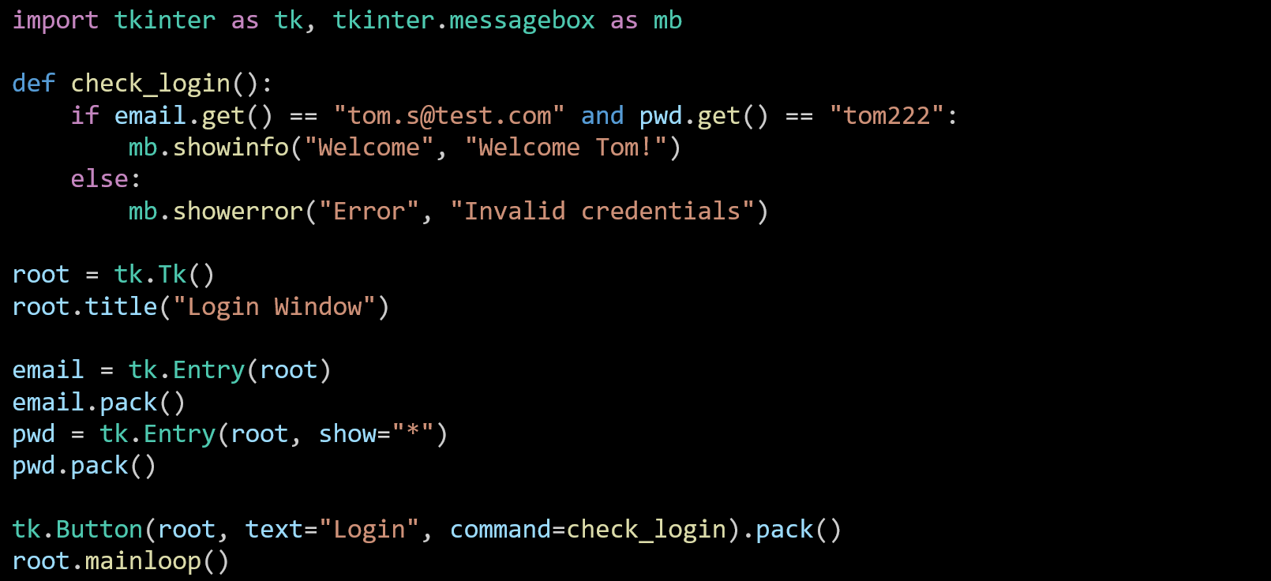
Problem-Solving with GUI (Python Version)
Entry() → lets the user type email and password.
show="*" → hides the password text.
check_login() → runs when the button is clicked.
If login info is correct → shows “Welcome Tom!”.
Otherwise → shows “Invalid credentials”.

Slide 97
Problem-Solving with GUI (Python Version)
Analogy: Just like logging into Canvas or MyGov, the system checks your email and password before letting you in.

Slide 98
Problem-Solving with GUI (Java Version)
Task: Build the Same Login App in Java Swing
Goal: Create a simple Java GUI that checks a user’s email and password, similar to the Python one.
Steps:
Use JFrame for the window.
Add a JTextField for email and JPasswordField for password.
Add a Login button.
When clicked, show a pop-up saying either “Welcome Tom!” or “Invalid”.

Slide 99
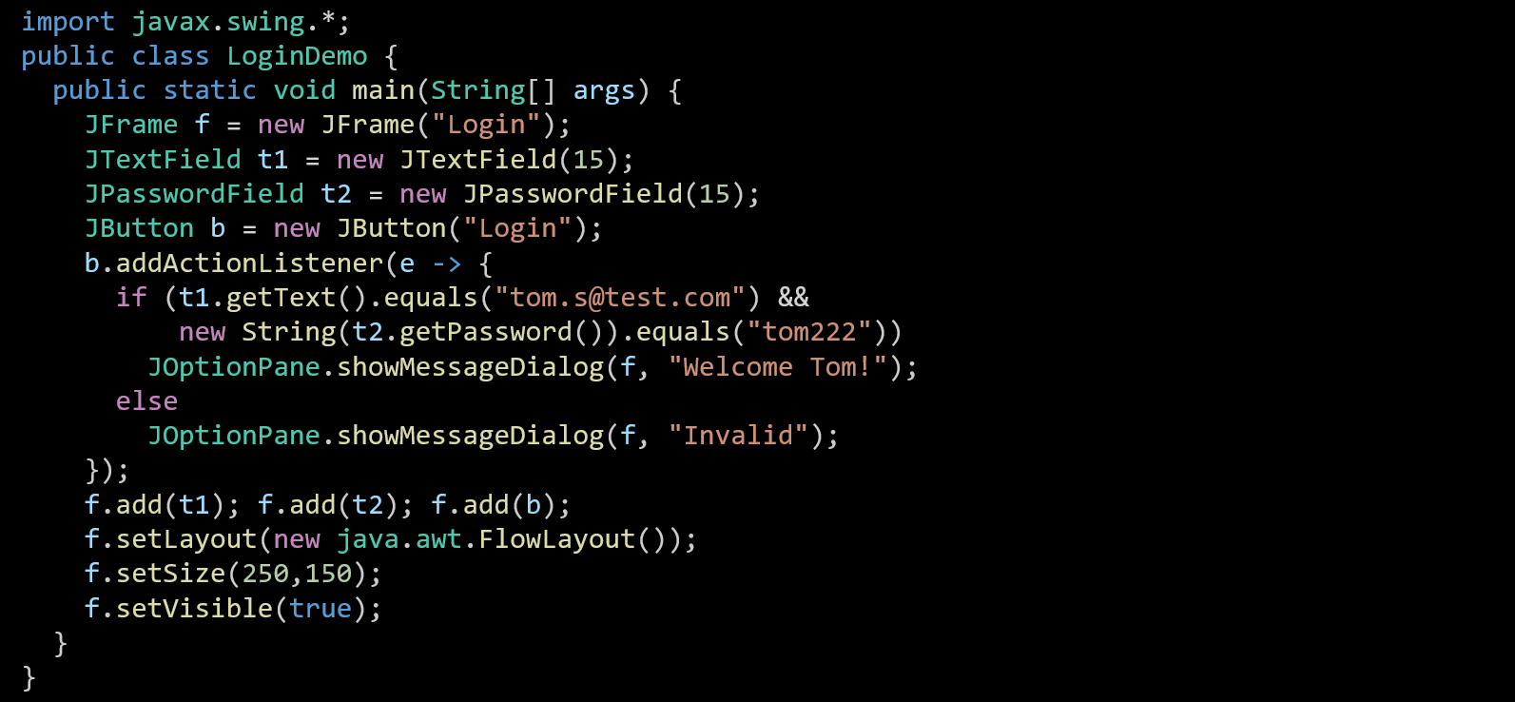
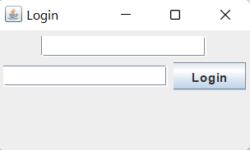
JFrame → window
JTextField → email box
JPasswordField → password box
JButton → clickable button
JOptionPane → pop-up message
Analogy: Like the Python version, but using Java’s Swing tools instead of Tkinter.

Slide 100
MQs designed in Week 10 (Python Tkinter)
Which Tkinter widget is used for selecting one option from multiple choices?
A) Label
B) Checkbutton
C) Radiobutton
D) Listbox
Answer: C - Reason: Radiobutton allows users to choose a single option among several; Checkbutton allows multiple selections.

Slide 101
MQs designed in Week 10 (Python Tkinter)
In Tkinter, which function is used to start the GUI event loop?
A) mainloop()
B) run()
C) exec()
D) loop()
Answer: A - Reason: root.mainloop() keeps the window responsive, processing user actions until closed.

Slide 102
MQs designed in Week 10 (Python Tkinter)
Which Tkinter widget is used to accept multi-line text input? A) Entry B) Text C) Label D) Listbox
Answer: B - : Text supports multi-line input; Entry is for single-line text.

Slide 103
MQs designed in Week 10 (Python Tkinter)
What does the command parameter in a Button widget define? A) The button’s label text B) The variable name of the button C) The function to be called when the button is clicked D) The background color
Answer: C - Reason: command binds a callback function that executes when the user clicks the button.

Slide 104
MQs designed in Week 10 (Python Tkinter)
Which layout manager automatically places widgets side-by-side (left to right)? A) grid() B) pack() with side=LEFT C) place() D) align()
Answer: B - Reason: Using pack(side=LEFT) arranges widgets horizontally.

Slide 105
MQs designed in Week 10 (Python Tkinter)
What is the purpose of the Toplevel() widget? A) To replace the root window B) To create a secondary pop-up window C) To terminate the mainloop D) To display a text label
Answer: B - Reason: Toplevel opens a separate independent window (e.g., report or help dialog).

Slide 106
MQs designed in Week 10 (JavaFX GUI)
Which JavaFX control is used for single-line text input? A) Label B) TextField C) TextArea D) PasswordField
Answer: B - Reason: TextField accepts single-line input; TextArea allows multi-line.

Slide 107
MQs designed in Week 10 (JavaFX GUI)
Which container arranges its child nodes vertically? A) HBox B) VBox C) BorderPane D) GridPane
Answer: B - Reason: VBox stacks nodes one below another.

Slide 108
MQs designed in Week 10 (JavaFX GUI)
Which method launches a JavaFX application? A) start() B) init() C) launch() D) run()
Answer: C - Reason: Application.launch(args) starts the JavaFX runtime and opens the first stage.

Slide 109
MQs designed in Week 10 (JavaFX GUI)
Which JavaFX control allows users to select one option from a list of choices? A) RadioButton B) CheckBox C) ListView D) Label
Answer: A - Reason: RadioButton (often grouped in ToggleGroup) provides mutually exclusive selection.

Slide 110
MQs designed in Week 10 (JavaFX GUI)
In an MVC JavaFX app, which component handles ActionEvent from a button? A) FXML file B) Controller class C) Stage D) Scene
Answer: B - Reason: The controller defines event-handling methods linked via onAction.

Slide 111
MQs designed in Week 10 (JavaFX GUI)
Which FXML tag correctly defines a button label in the UI XML? A) <Button fx:id="btn" text="Login"/> B) <Button id="btn" name="Login"/> C) <Button fx:id="btn">Login</Button> D) <Button label="Login"/>
Answer: A - Reason: fx:id links the button to the controller variable, and text defines the label text.

Slide 112

Happy Learning and Bright Futures Ahead! Dr. Farshid Keivanian Stay Connected: linkedin.com/in/farshid-keivanian github.com/FarshidKeivanian
Education is the most powerful weapon you can use to change the world. — Nelson Mandela

